Slide 1
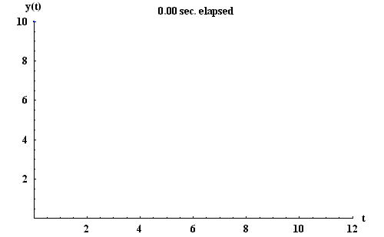
Infinite Series Some “good” lecture examples

Slide 2
Infinite Series Some “good” lecture examples
Neils Henrik Abel (1826)
Oliver Heaviside
“Divergent series are the Devil, and it is a shame to base on them any demonstration whatsoever”.
“…This series is divergent; therefore, we may be able to do something with it”.

Slide 3
Definitions

Slide 4
Some “nice” series to use for the definitions...

Slide 5
Another “common” series
Finding a formula for S_{n} can be tricky so using the definition of convergence is usually not a “great” example

Slide 6
The Tests
Test for Divergence
Integral Test
Comparison Test
Limit Comparison Test
Ratio Test
Root Test
Alternating Series Test
Absolute / Conditional Convergence

Slide 7
The confusion begins…
When discussing the Integral Test, it is required that the function in question satisfy the following conditions.
f(n)=a_{n} (on the given interval)
f(x) must be positive (on the given interval)
f(x) must be continuous (on the given interval)
f(x) must be (eventually) decreasing
It is usually here that we recall improper integrals of the form
We know these integrals are finite (convergent) when p > 1 and infinite (divergent ) when p ≤ 1

Slide 8
This one is my fault
This usually leads me to say “we know that…
Convergent when p>1
Divergent when p≤1
because of the Integral test”.
However this is NOT entirely true.
If p ≤ 0, the function is NOT decreasing and so we can not use the Integral Test.
We can still conclude divergence when p ≤ 0 but using the Test for divergence NOT the Integral Test.

Slide 9
Comparison Test
Given a_{n} ≤ b_{n} (where both have positive terms)
If is convergent then is convergent also.
If is divergent then is divergent also.
Typical example
A bit tougher example

Slide 10
Theorems

Slide 11
Another Comparison Test Example

Slide 12
Limit Comparison Test
Given Σa_{n} and Σb_{n} (where both have positive terms)
Consider
If then both series have the same behavior
That is either both converge or both diverge
Typical example

Slide 13
Alternating Series Test
The series Σ(-1)^{n} a_{n} (where a_{n} has only positive terms) converges if
and
Typical example
The problem I have found is that students do not want to check both conditions.
They will often assume (incorrectly) that if
then decreasing must be true.

Slide 14
Two Examples to “fix” this misconception
VERSUS

Slide 15
Do limits go to zero?
VERSUS
YES

Slide 16
Are they decreasing?
VERSUS
NO

Slide 17
This tells us that AST does not apply…
VERSUS
But what is more important is to show that…
DIVERGES
CONVERGES

Slide 18
Ratio Test & Root Test
For the series Σa_{n} consider
If L < 1 then Σa_{n} is convergent
If L > 1 then Σa_{n} is divergent
If L = 1 the test is inconclusive
Example
Example OR

Slide 19
A few others? I am not sure of these…

